Slide 1


Slide 2
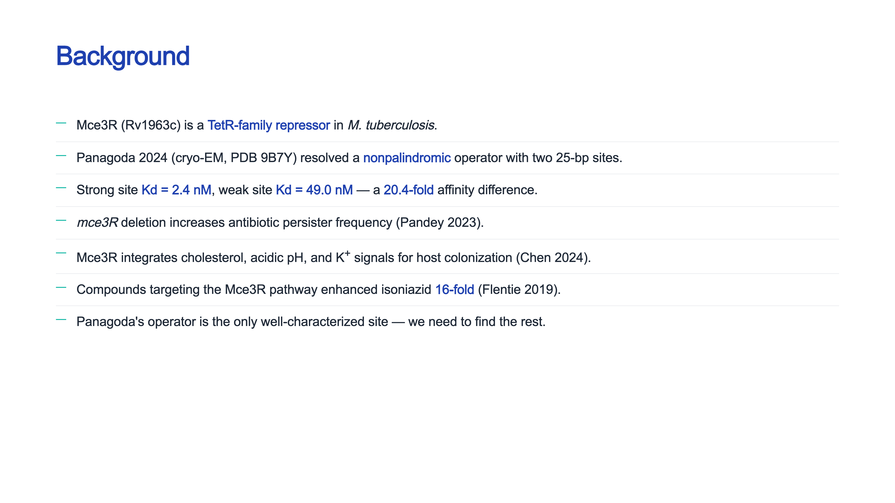

Slide 3
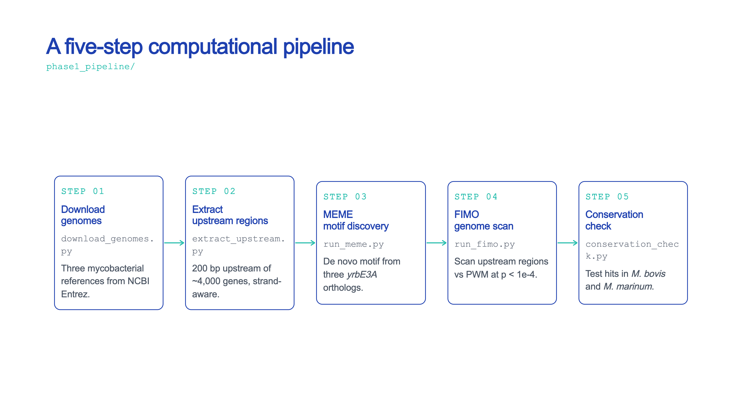

Slide 4
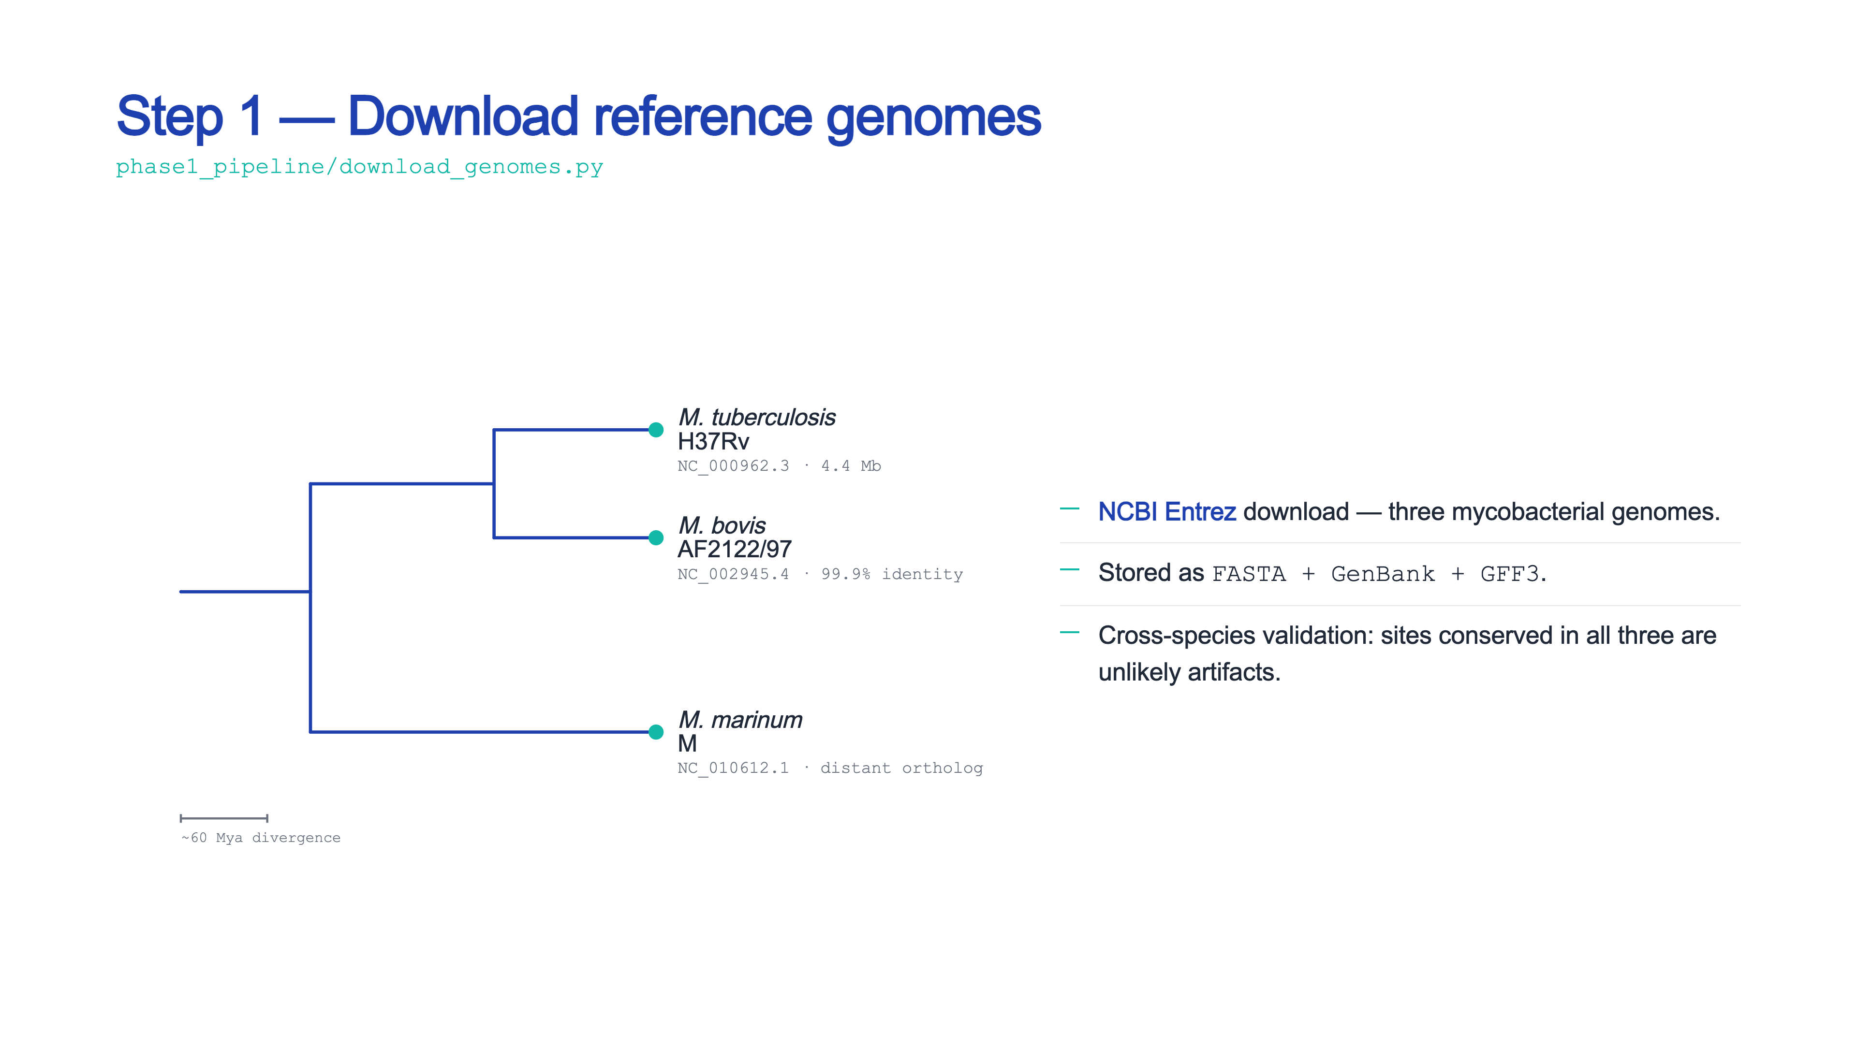

Slide 5
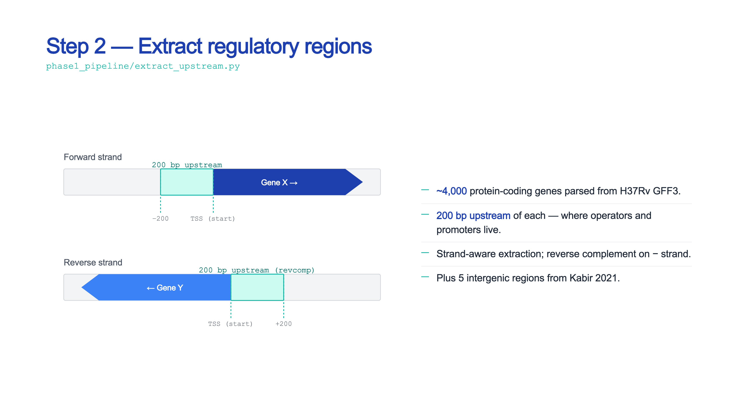

Slide 6
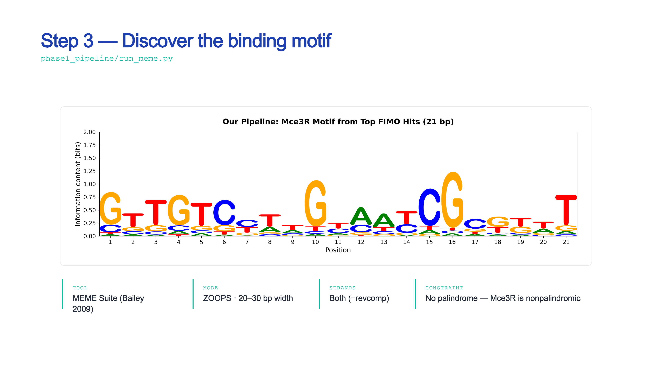

Slide 7
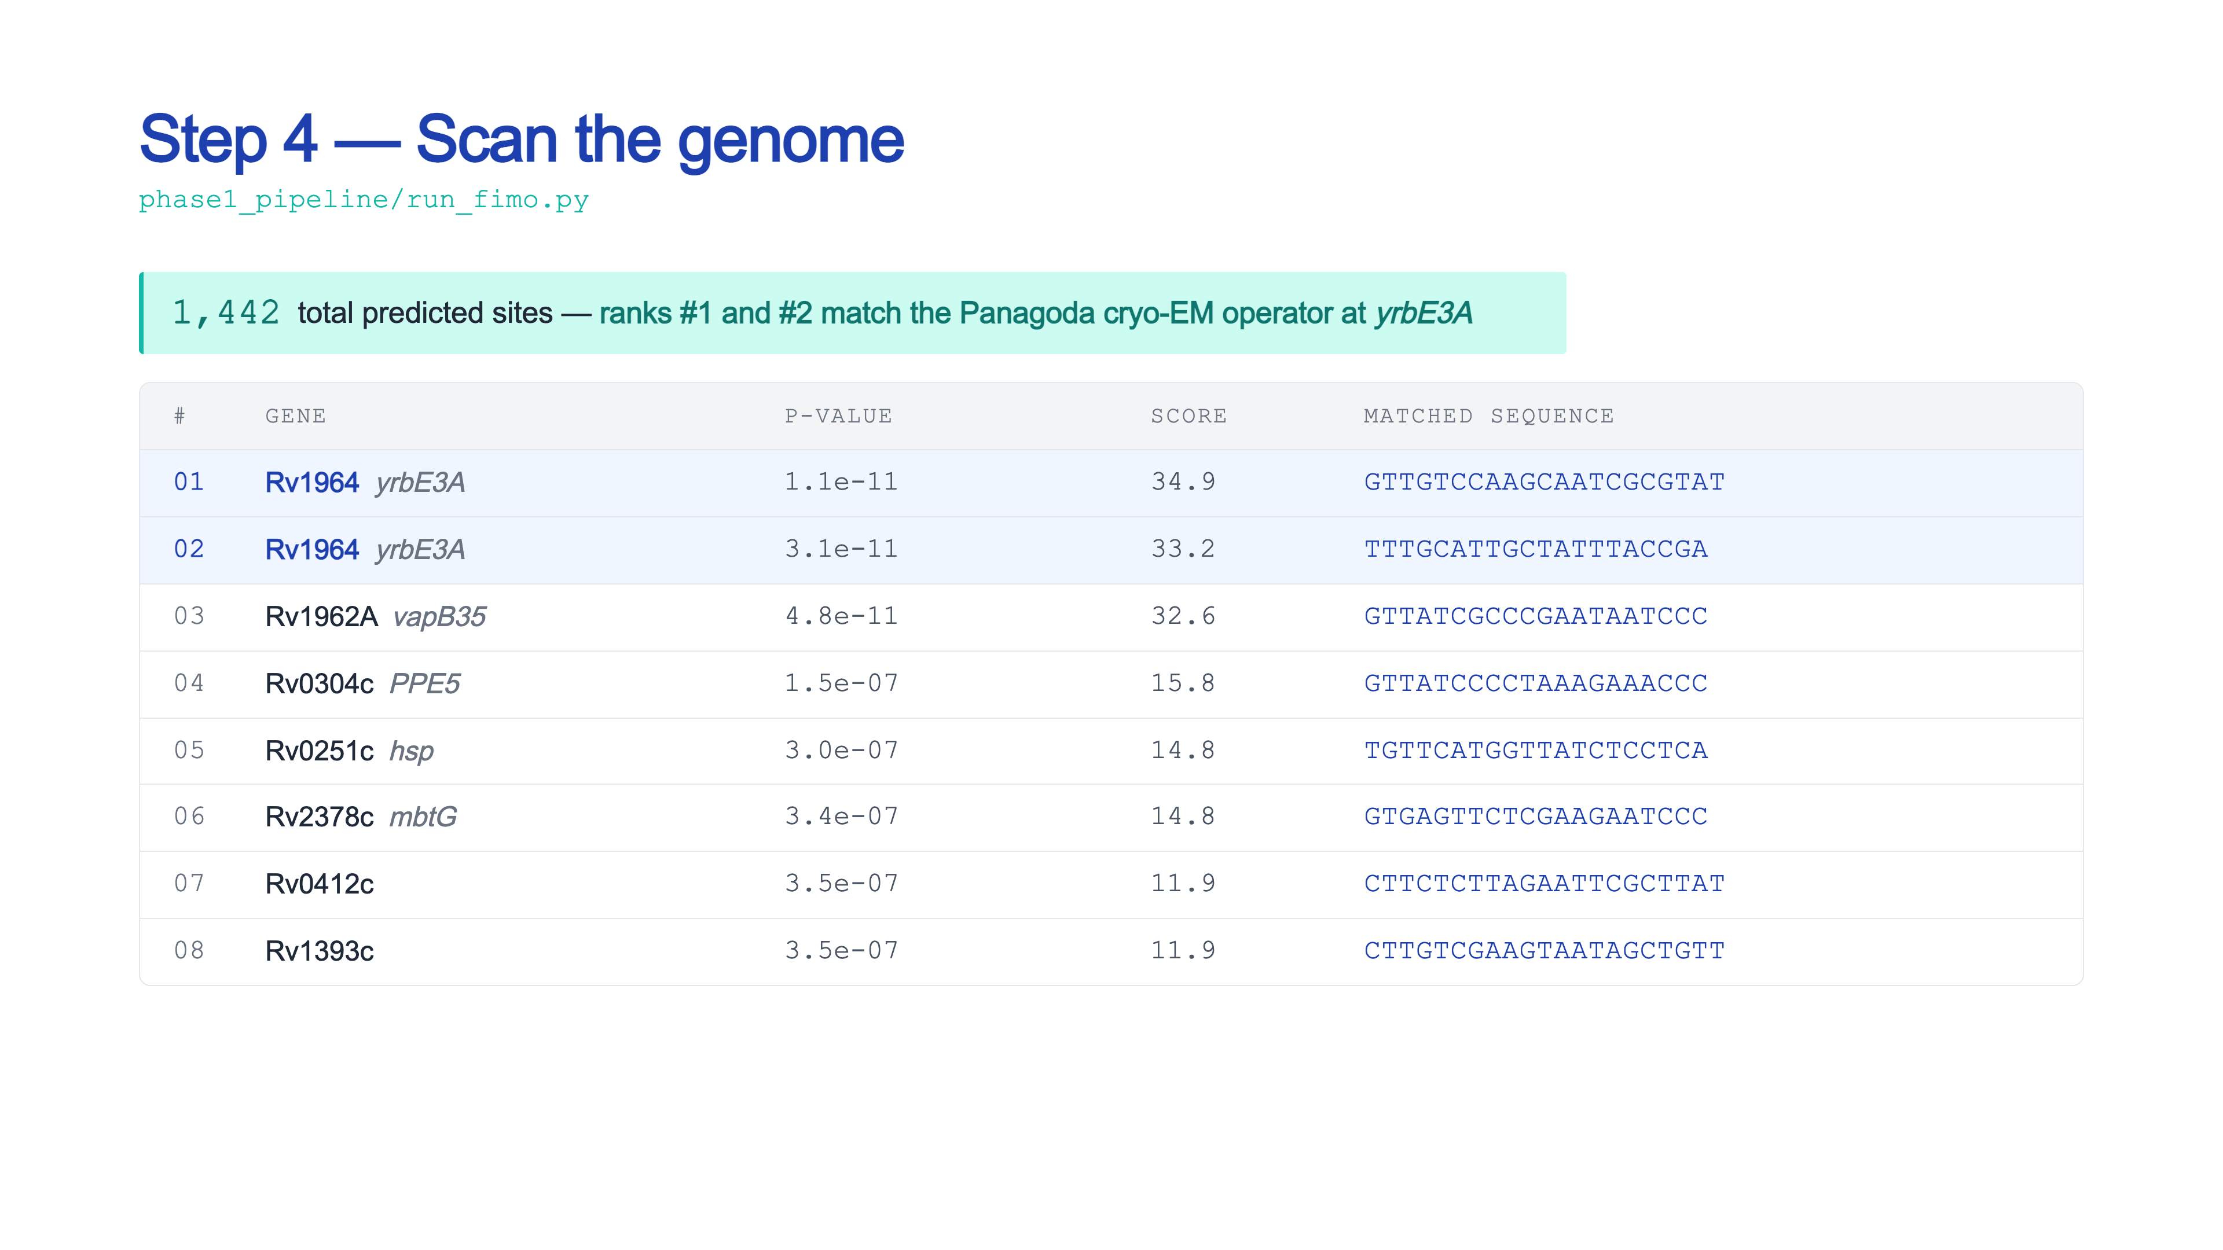

Slide 8
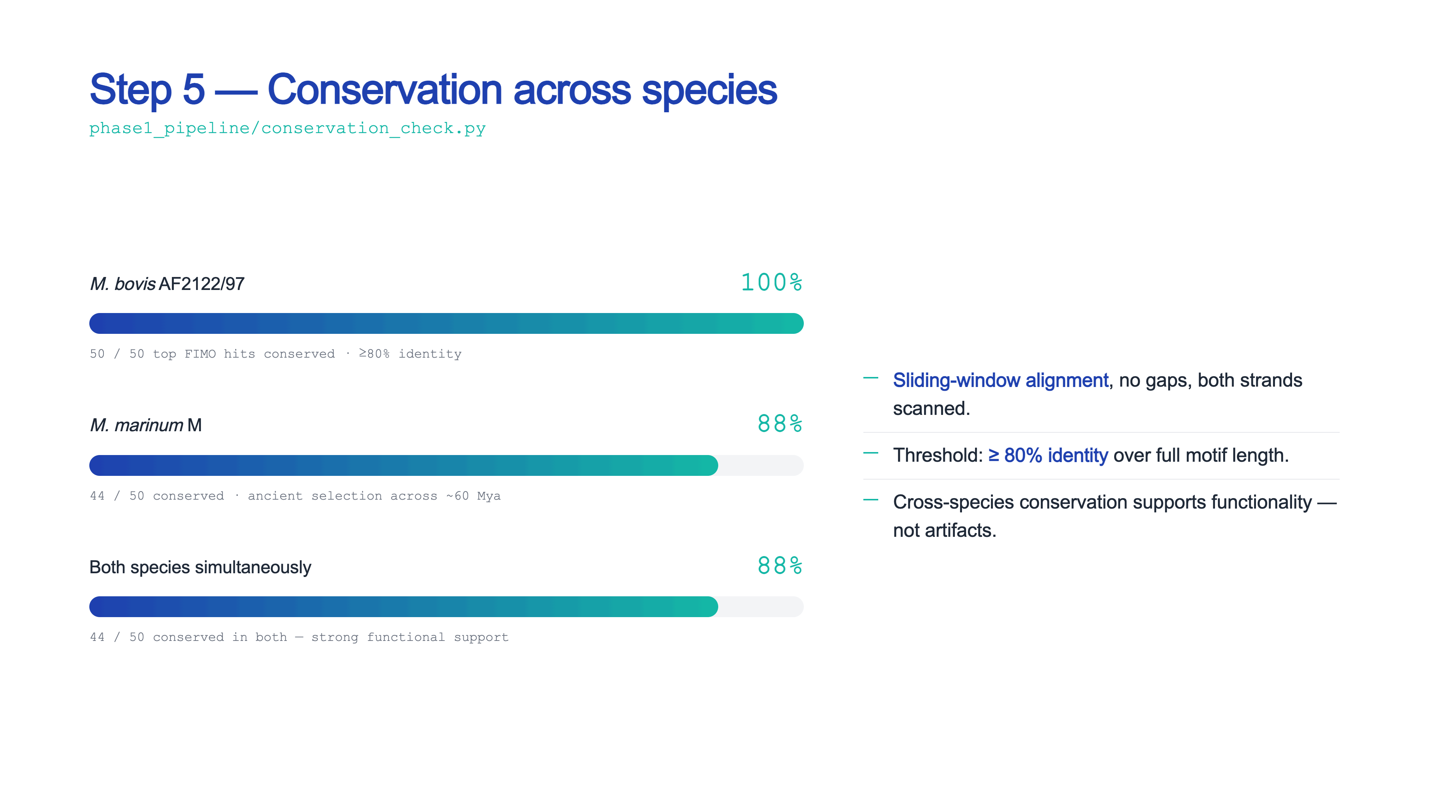

Slide 9
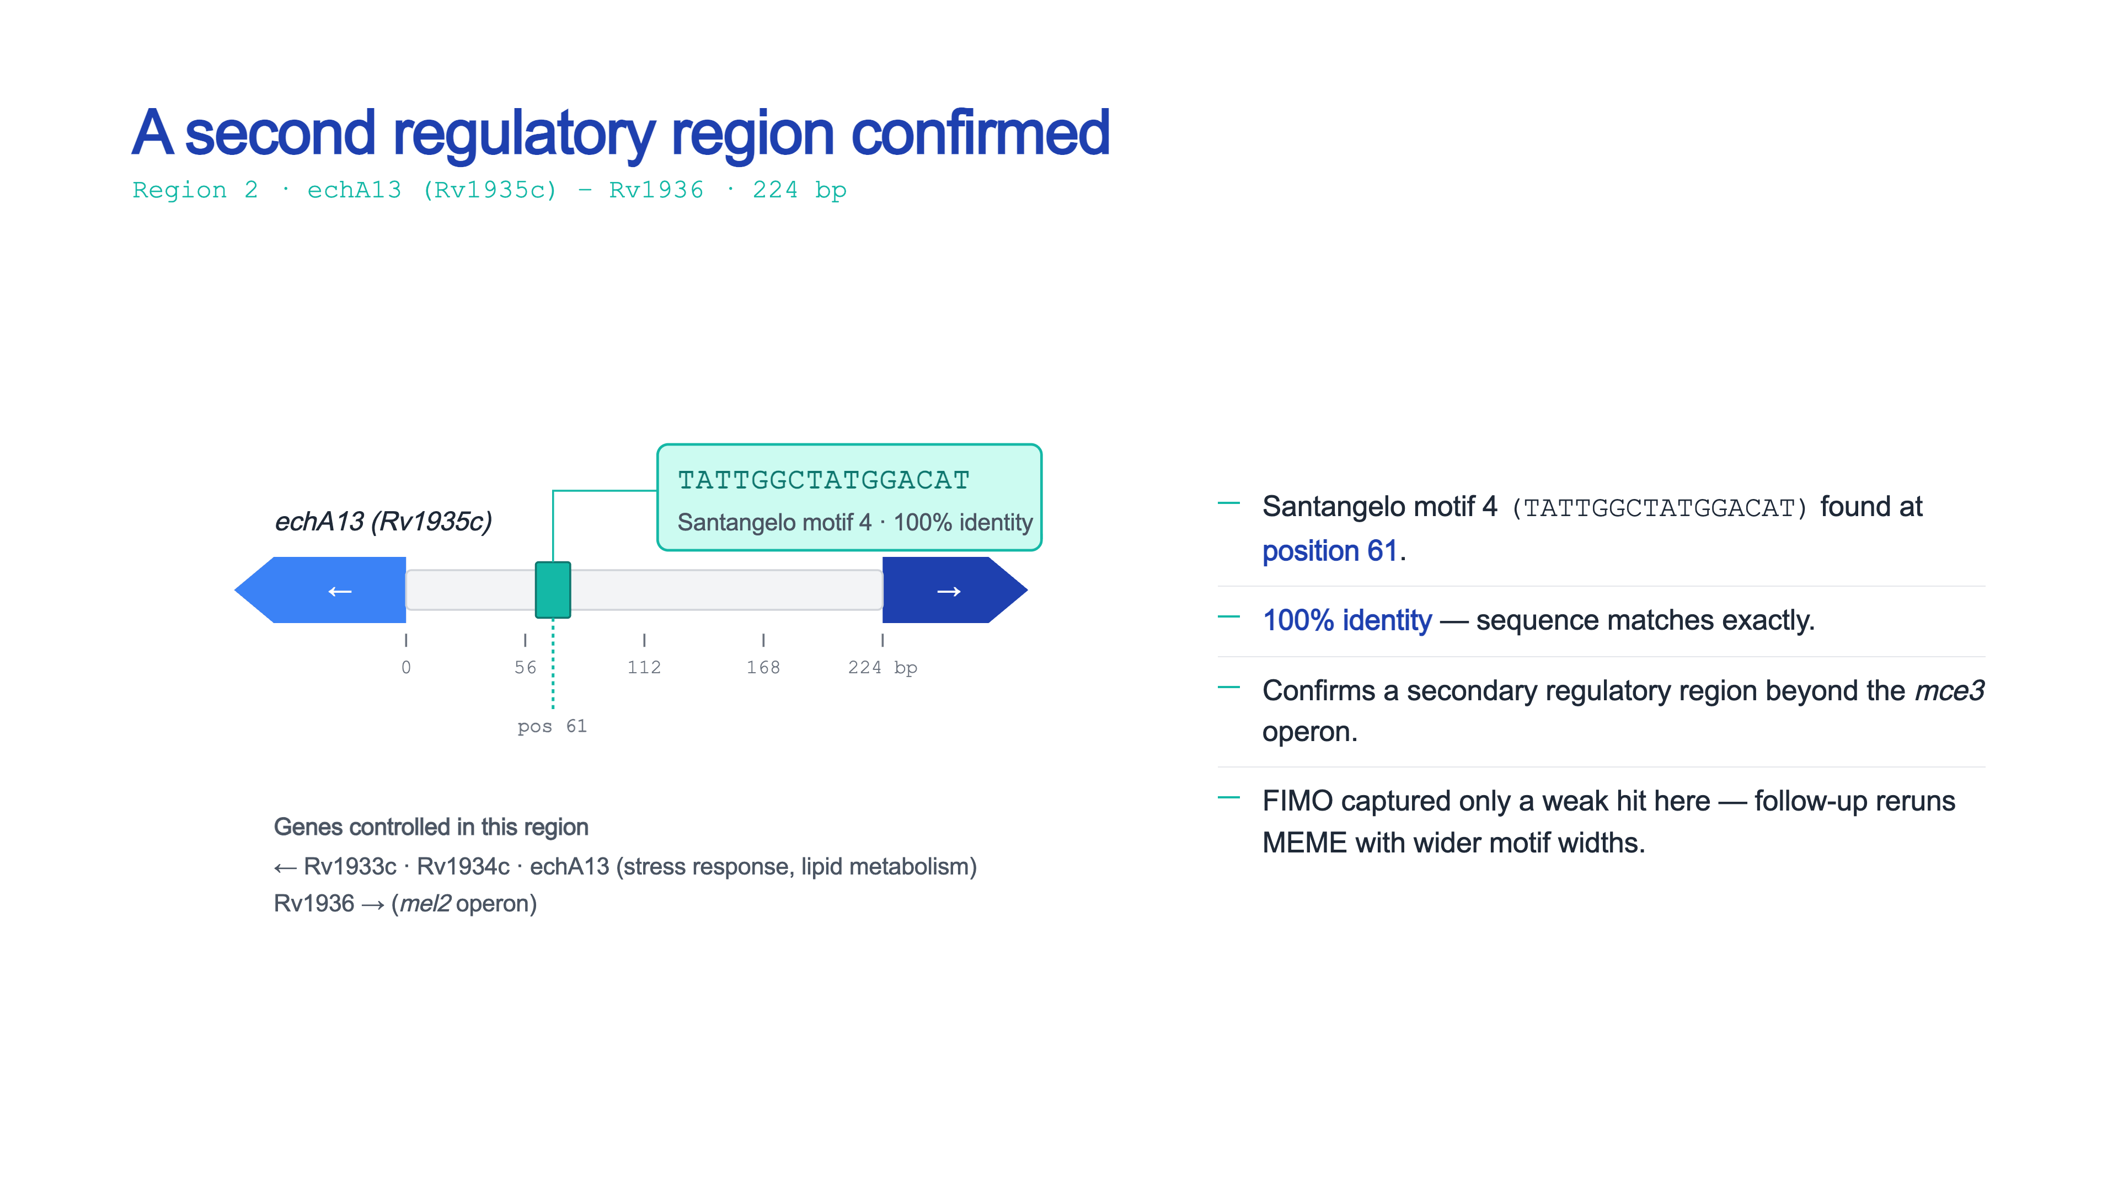

Slide 10
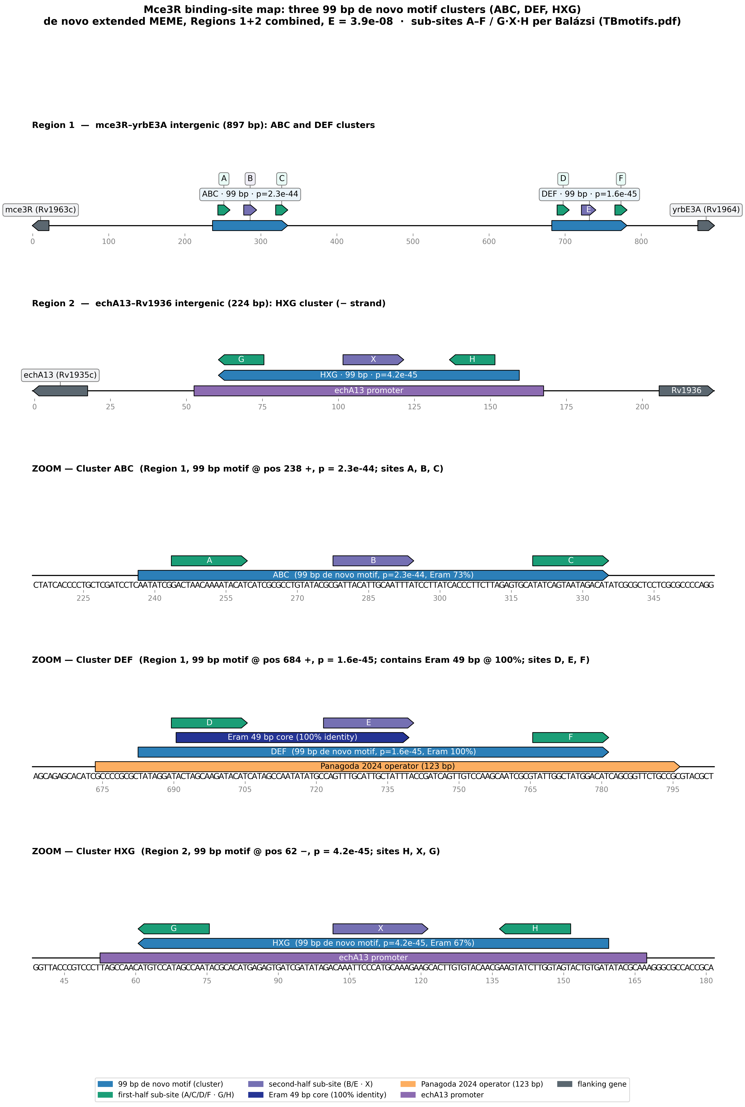
Three 99 bp motif clusters — ABC, DEF, HXG
The 99 bp motif occurs three times; each occurrence is one of three suspected binding clusters in the collaborator's annotated schematic.
ABC mce3R–yrbE3A, proximal (near mce3R): 99 bp at position 238 (+), p = 2.3 × 10⁻⁴⁴; sub-sites A, B, C.
DEF mce3R–yrbE3A, distal (near yrbE3A): 99 bp at position 684 (+), p = 1.6 × 10⁻⁴⁵; contains the 49 bp core at 100% identity ; sites D, E, F.
HXG echA13–Rv1936, minus strand: 99 bp at position 62 (−) , p = 4.2 × 10⁻⁴⁵; sub-sites H, X, G.
Every sub-site core matches a published instance exactly ( 0 mismatches ); equivalence A = C = D = F = rcH = rcG and B = D = X.

Slide 11
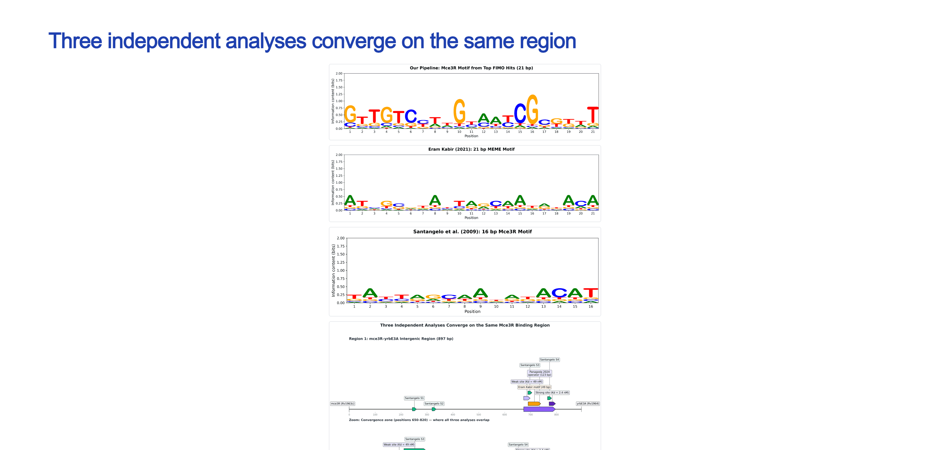
Three independent analyses converge on the same region

Slide 12
